Slide 1
Taxing in the real world
Why taxation is superior to voluntary contributions such as philanthropy and CSR

Slide 2
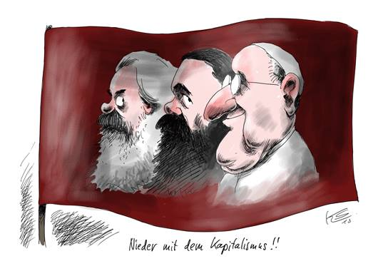
Church and Taxation???

Slide 3

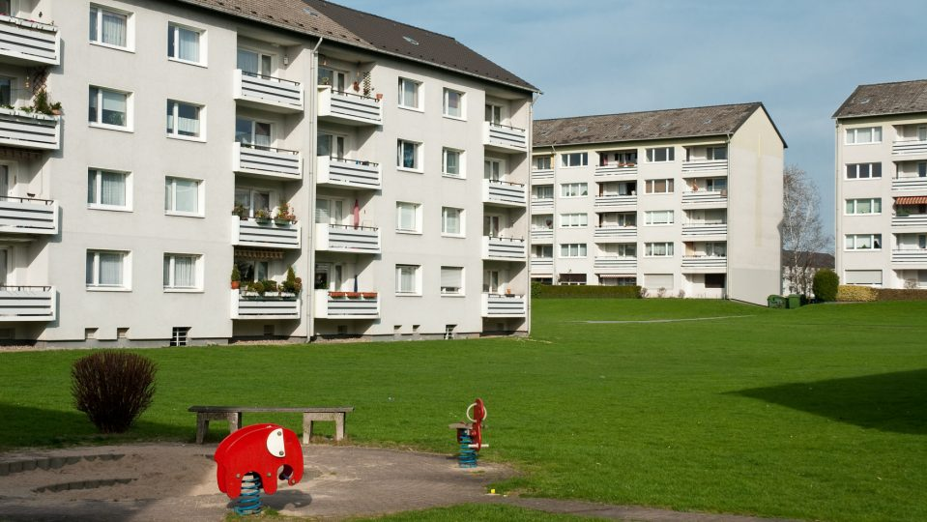
Ambition and Pragmatism

Slide 4
Skeptical interventions
More money than ever – in tax havens

Slide 5
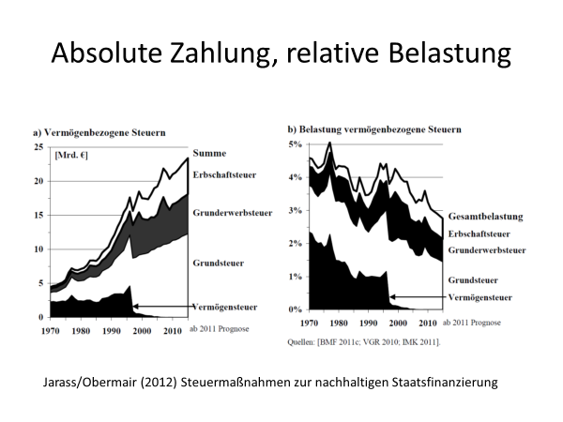
Absolute payments and relative burden of the wealthy

Slide 6
Alleviating the burden for the wealthy
 | Germany | Kenya | Zambia
Wealth Tax | Suspended | None | None
Capital Income (interests) | 25% Flat Tax | 10-25% | 25%
Capital Income (dividends) | 25% Flat Tax | 5-10% | 15%
Capital Gains | 25% Flat Tax | 5% | None
Inheritance & Gift Tax | Yes, but riddled with holes | None | None
Real Property Taxation | Yes, but undergoing reform | Yes | Yes
Real Property Transfer Tax | Yes, but undergoing reform | Yes | Yes

Slide 7
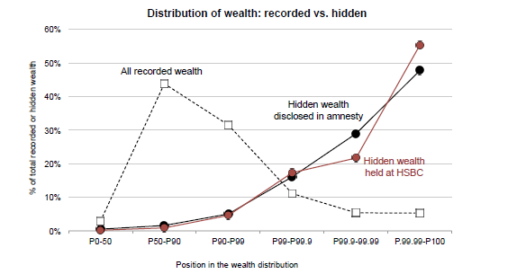
How wealthy are the wealthy?
Zucman, G. et al. (Sept. 2017) Tax Evasion and Inequality

Slide 8
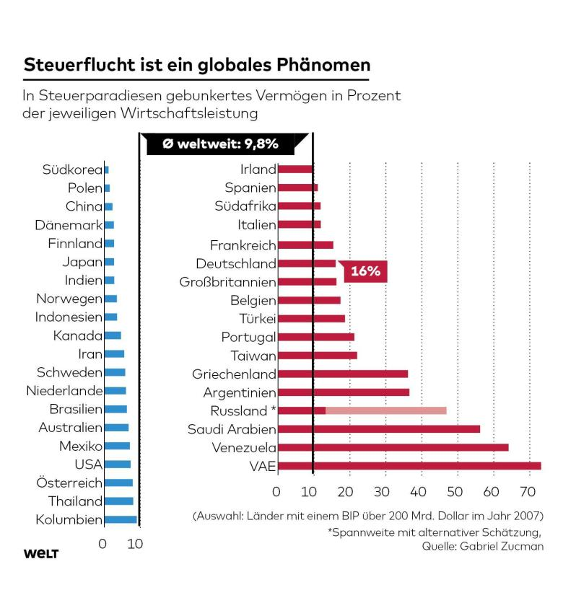

Slide 9
Skeptical interventsions
More money than ever – in tax havens
Philanthropy and CSR vs. Government and democracy
Free-Riding and the Common-Wealth
„Spaceship“ and Prison of the Wealthy

Slide 10
A world of its own
As our findings suggest, the pursuit of self-interest is a more fundamental motive among society’s elite, and the increased want associated with greater wealth and status can promote wrongdoing. (Paul Piff)
(M)ost millionaires don’t have enough wealth to feel secure. As a result, many feel stuck on a treadmill, without a real sense of how much wealth would make them satisfied enough to get off. Millionaires’ constant striving comes mainly from pressure they feel to maintain the high standard of living they have established for their families, whom they value above all else. (UBS)
Millennials are more insecure and conscious about how their wealth compares to that of peers …. With so much of their peers’ lifestyle and spending information available online and through social media, Millennials are most likely to say they feel pressure to “keep up with the Joneses.” This sense of competition manifests itself in their career decisions and personal behavior. (UBS)

Slide 11
Skeptical interventions
More money than ever – in tax havens
Philanthropy and CSR vs. Government and democracy
Free-Riding and the Common-Wealth
„Spaceship“ and Prison of the Wealthy
Wealth and political power

Slide 12
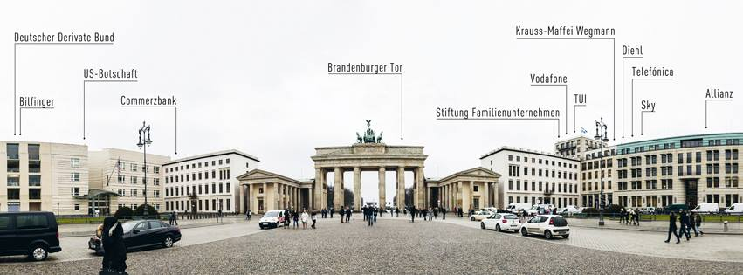
Lobbyism at work (1)

Slide 13
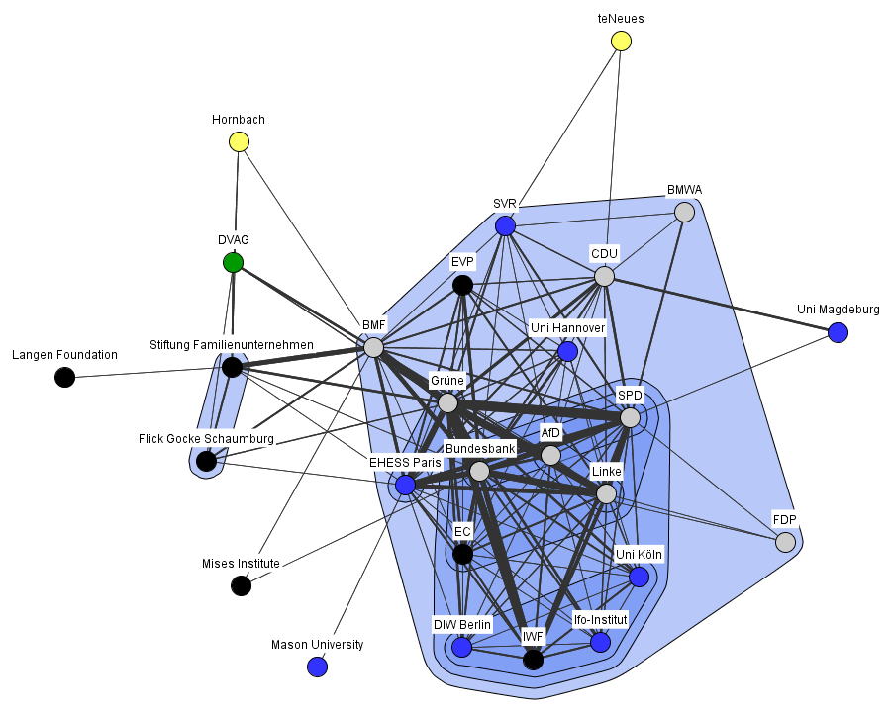
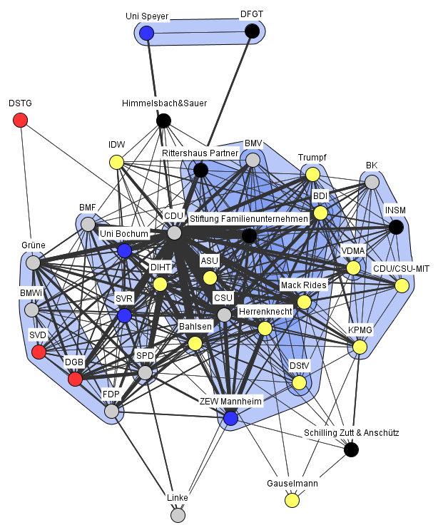
Lobbyismus at work (2)
Piketty/ Supreme Court verdict 2013/14
Status second half of 2015
Alexander Leipold Ergebnisse einer Diskursnetzwerkanalyse zur Debatte um die Reform der Erbschaftsteuer in Deutschland, 2013-2016

Slide 14
Inheritance Tax-Reform:
Whom does the FAZ quote?
Quelle: Alexander Leipold

Slide 15
Skeptical Resume
Around 2000 a survey in the USA found that with existing legislation UHNWIs handed out 16% to Charities, 47% to heirs, 37% to the state.
Could they do as they like, they would give 26% to Charities, 64% to heirs and only 9% to the state.
(Shervish/Boston College survey among 112 US-UHNWIs, in Collins/Gates)

Slide 16
Historic background of CST
Starting Mid-19th Century, at a time of hightened tension between „Capital and Labour“
Method: See – Judge – Act
Historic implementation: Germany and Austria

Slide 17


Income distribution Germany
Catholic Social Teaching –Ordoliberalism (ca. until 1989)
Neoliberalism (1989 onwards)

Slide 18
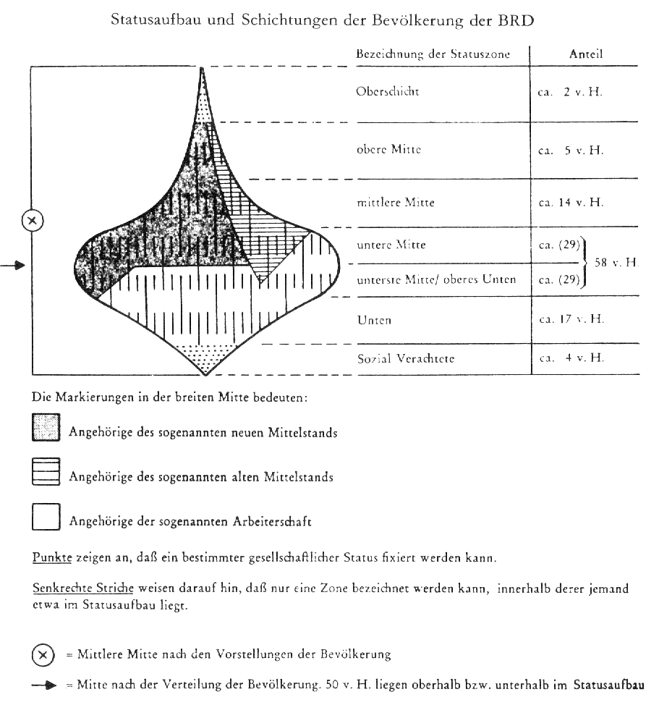
The „Bolte Onion“, i.e. income distribution up to 1989 and the thinning of German middle class since 1989

Slide 19
How CST operates
Principles and values of Catholic Social Teaching, in dialogue with other world-views
Developing fairer taxation laws, leading towards a more just & sustainable society
Unfair taxation system, increasing inequality burdening the poor more than the wealthy, climate change, tax evasion, IFFs....

Slide 20
Values and principles of Catholic Social Teaching
Framework conditions: truth, freedom and participation
Personalism/the rights of individual Human Persons | Common Good/ the Universal Destination of Goods
Solidarity | Subsidiarity
Justice | Sustainability
Universal Love (of everybody) | Preferential Option for the Poor

Slide 21
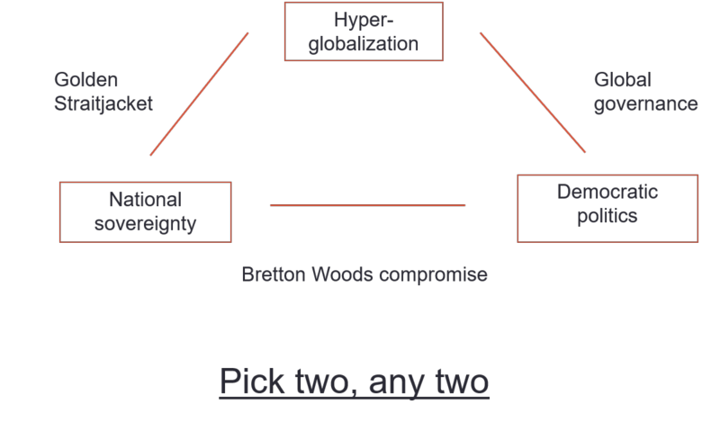

Slide 22
Neoliberally inspired order | Catholic Social Teaching -inspired order
Free Markets (incl. non-prized externalities, privatized gains, socialized losses…)
Individualistic Homo Oeconomicus
Lead science: Mathematics and statistics
Growth and quantity, consumerism and waste
Free Trade, Global Value Chains
Business to generate shareholder value, CSR
Free capital movement above labour
Paid labour
Rewards individual “performance” and merits
Individual command of property
Maximize individual interests & profits
Lobbyism, oligarchy, lack of transparency
Private, capital based social security systems
(tax)competition, tax havens… → survival of the fittest
Little state
Little tax

Slide 23
Neoliberally inspired order | Catholic Social Teaching -inspired order
Free Markets (incl. non-prized externalities, privatized gains, socialized losses…) | Socially just and ecologically sustainably regulated markets
Individualistic Homo Oeconomicus | Concept of the Human Person
Lead science: Mathematics and statistics | Lead science: Sociology
Growth and quantity, consumerism and waste | Growth agnostic, but quality, durability and recycling
Free Trade, Global Value Chains | Fair Trade, Regional production chains
Business to generate shareholder value, CSR | Business to serve the community, “Social Partnership”, CC&CSA
Free capital movement above labour | Labour above capital
Paid labour | All forms of labour
Rewards individual “performance” and merits | Yes, but only if equality of opportunity!
Individual command of property | Property has a social and ecological mortgage,
Maximize individual interests & profits | Global Common Good (“Solidarism”)
Lobbyism, oligarchy, lack of transparency | Transparency, democracy, participation
Private, capital based social security systems | Solidarity systems for social security systems
(tax)competition, tax havens… → survival of the fittest | (tax)cooperation → human evolutionary advantage
Little state | Adequate state
Little tax | Adequate tax

Slide 24
Relevant framework conditions
Iustitia legislativa et commutative (Legislative and commutative justice)
Start with realities
Think global, not national
Think complex about instruments reducing poverty
Less tax injustice rather than more tax justice

Slide 25
Taxes: More than just money!
Generating revenue for public investment and financing of public goods and services
Generating funds for redistribution, empower the poor, reduce inequality
Putting a prize on so-far “unprized externalities” (Pigovian Taxes), thus reducing environmental degradation as well as other damaging products and behaviour
Redirecting private and corporate funds into more just and sustainable investment.
Assisting the transformation towards a socially more just and ecologically more sustainable model for economy and society.

Slide 26
Prior to new laws: Enforce the existing
Combat illegal and illicit activities
Replace tax competition with tax cooperation
End tax havens
Public transparency of tax haven Shell Companies, Trusts, SPVs
Equal transparency of all persons towards tax administrations
Public transparency of TNCs (public CbCR)
Transparency of TNC-UBOs towards tax administrations
Transparency of real estate or financial asset ownership (?)
Adequate staffing for investigative and enforcement authorities
Specific units for TNCs, HNWIs and UHNWIs
Protection of Whistleblower

Slide 27
Diminish inequality, secure participation of all
Level playing field for all in business
Review tax base, tax privileges and businesses
Principle of Ability to Pay, progressive direct taxation

Slide 28
Shifting the tax burden
 | Germany |  | Kenya |  | Zambia
 | 1975 | 2017 | 1974 | 2017 | 1970 | 2017
Top PIT Rate | 56% | 45% | 65% | 30% | 45% | 37.5%
Sales Tax or VAT | 11%-5.5% | 19%-7%-0% | 10% | 16%-0% | n.a | 16%-0%

Slide 29
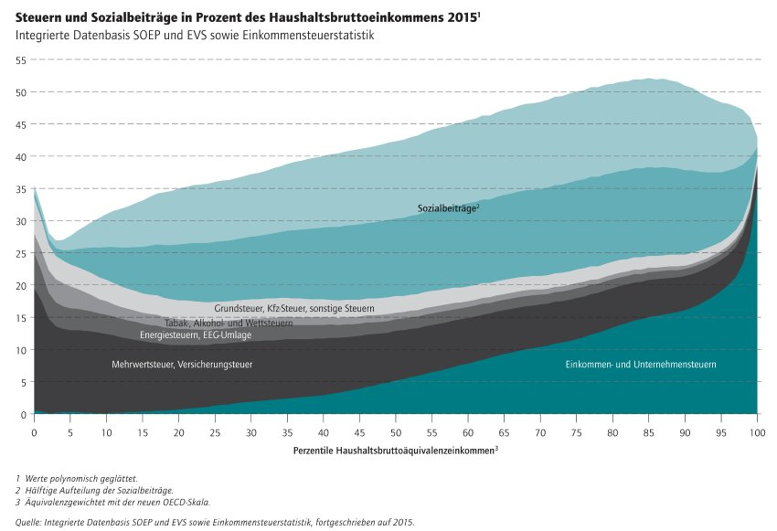
Relative tax burden, due to direct and indirect taxation as well as mandatory SSCs
Bach u.a. (2016) Wer trägt die Ungleichheit in Deutschland?

Slide 30
Diminish inequality, secure participation of all
Level playing field for all in business
Review tax base, tax privileges and businesses
Principle of Ability to Pay, progressive taxation
Earned and unearned income → Wealth Tax
Prevent accumulation and power in the hands of few → Inheritance/Estate and Gift Tax

Slide 31
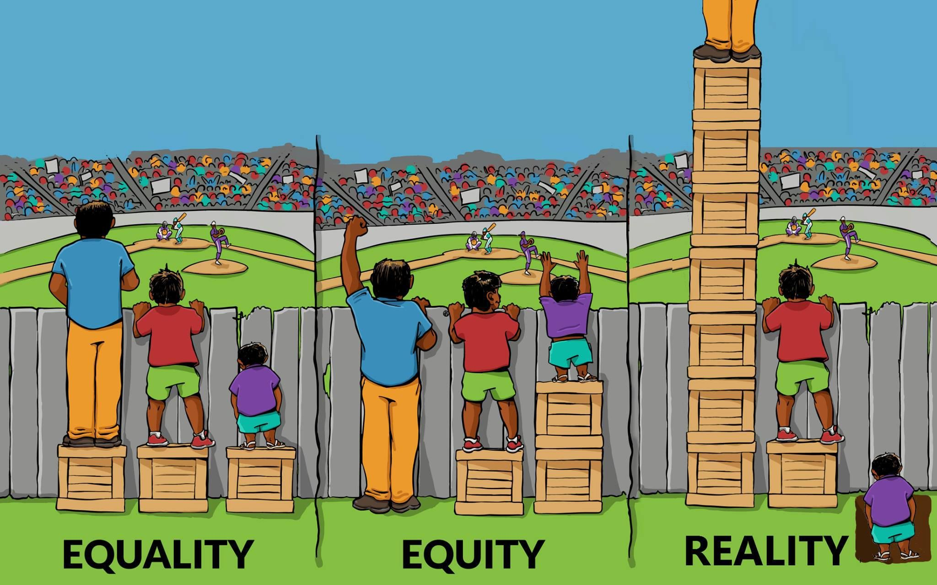
Install pro-poor policies

Slide 32
Advance socio-ecological transformation
Adjust public spending
Use tax to encourage investment advancing social justice and ecological sustainability
Use Pigovian Taxes for curbing damaging behaviour
Identify new and contemporary sources of taxation
Handle the change in human labour (Unconditio-nal Income Grant? Social Engagement Stipend…)
The special issue of land?

Slide 33
Outlook
Tax and enforcement institutions are strong institutions of the state
There is wide agreement on fighting illicit and illegal practices
There is wide agreement to address climate change

Slide 34
Summary
In the real world with real people I am of the opinion that contributions to the common good should not primarily moral and voluntary, but legal and mandatory, which is why aggressive tax avoidance and tax evasion and other tax related crimes need to be curbed.
Taxes should be according the Principles of Ability to Pay, which supports progressive taxation rather than Flat Taxes.
Direct taxes are preferable towards indirect taxes, because the latter disadvantage over proportionately the poor
Unearned income and wealth needs to be taxed more heavily than earned income and wealth.
Taxes and levies could be one way to curb the over-exploitation of natural goods and/or push back damaging consumption, e.g. Carbon Fuels.
In order to make this happen, tax administrations and investigative bodies into financial crime need to be adequately staffed and equipped, including legal instruments which enable them to do their national and transborder job.

Slide 35
https://www.youtube.com/watch?v=paaen3b44XY

Slide 36
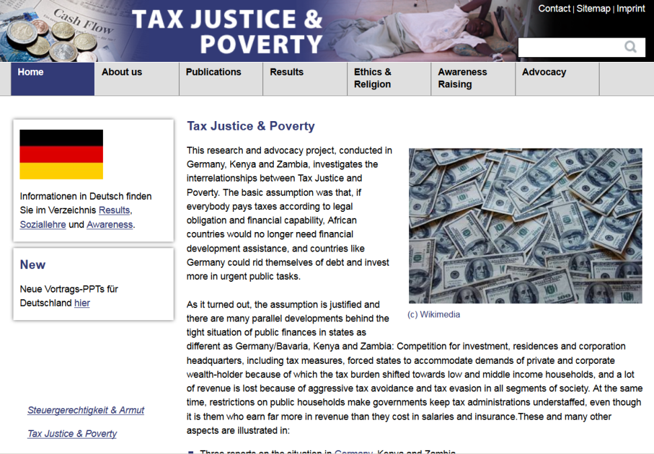
www.taxjustice-and-poverty.org

