Slide 1
Putting Findings of Research into all African Perspective
Improving DRM and Stemming IFFS
Tax Justice for Promoting Equality and Social Justice
Nairobi, Kenya
13 March 2019
Fanwell Kenala Bokosi, PhD
Executive Director

Slide 2
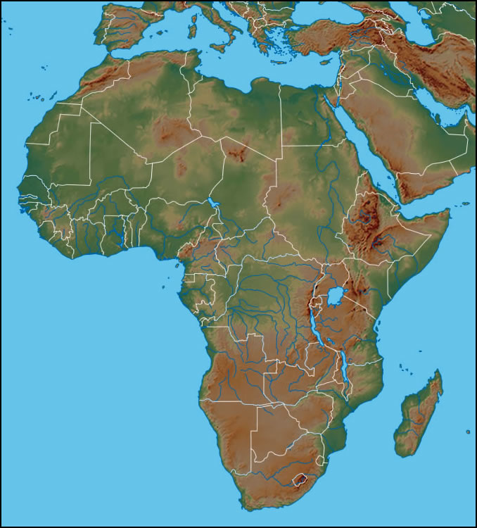
2017
External Debt Stock/GNI 33.5%
External Debt Stock/Exports 135.7%
Concessional/External Debt Stock 32.4%
$92 billion of outstanding African sovereign Eurobonds

Slide 3
2017
Tunisia
Morocco
External Debt Stock/GNI 35.7%
External Debt Stock/Exports 243.8%
Concessional/External Debt Stock 56.2 %
Algeria
Libya
Western Sahara
(Morocco)
Egypt
Mauritania
Senegal
Niger
Sudan
Eritrea
Djibouti
The Gambia
Mali
Burkina
Faso
Chad
Guinea-Bissau
Guinea
Benin
Nigeria
Ethiopia
Sierra Leone
Côte
d'Ivoire
Togo
Central African
Republic
Liberia
Ghana
South Sudan
Cameroon
Somalia
B=Burundi
EG
Uganda
Kenya
EG=Equatorial Guinea
São Tomé
and Príncipe
Gabon
Congo Republic
L=Lesotho
DR Congo
R
R=Rwanda
B
Tanzania
S=Swaziland
External Debt Stock/GNI 65.2%
External Debt Stock/Exports 179.4%
Concessional/External Debt Stock 24.2 %
Comoros
Seychelles
Angola
Mayotte (France)
Zambia
Malawi
Mozambique
Namibia
Zimbabwe
Madagascar
Botswana
S
L
South Africa

Slide 4
Tenor (yrs.) | $ (bn) | Maturity | Coupon
5 | 0.50 | 24-Jun-19 | 5.90%
10 | 1.50 | 24-Jun-24 | 6.90%
10 | 1.00 | 28-Feb-28 | 7.30%
30 | 1.00 | 28-Feb-48 | 8.30%
Tunisia
Morocco
Algeria
Libya
Western Sahara
(Morocco)
Egypt
Mauritania
$4.00bn
Senegal
Niger
Sudan
Eritrea
Djibouti
The Gambia
Mali
Burkina
Faso
Chad
Guinea-Bissau
Guinea
Benin
Nigeria
Ethiopia
Sierra Leone
Côte
d'Ivoire
Togo
Central African
Republic
Liberia
Ghana
South Sudan
Cameroon
Somalia
B=Burundi
EG
Uganda
EG=Equatorial Guinea
São Tomé
and Príncipe
Gabon
Kenya
L=Lesotho
Tenor (yrs.) | $ (bn) | Maturity | Coupon
10 | 0.75 | 20-Sep-22 | 5.40%
10 | 1.00 | 14-Apr-24 | 8.50%
12 | 1.25 | 30-Jul-27 | 9.00%
Congo Republic
DR Congo
R
B
R=Rwanda
Tanzania
S=Swaziland
Comoros
Seychelles
Angola
Mayotte (France)
$3.00bn
Zambia
Malawi
Mozambique
Namibia
Zimbabwe
Madagascar
Botswana
S
L
South Africa

Slide 6
Concerns about global growth and that of China
A stronger US dollar
The average yield of African eurobonds increased from 5.3% to 7.4%
2018
Tough Year?
Sign of the Future?
Trade Tensions
African yields are 2.9 percentage points higher than the Rest of the world
AFRICAN PREMIUM
The Fed raising US rates

Slide 7
IMPLICATIONS OF THE INCREASE IN YIELDS
$ 1 Billion 10 Year Eurobond
5.3 %
7.4 %
$210 mn
$74 million a year
$53 mn per year
$530 mn interest in 10 yrs
$740 mn interest in 10 years

Slide 8
Exchange Rate Risk
Credit Risk
7.4 %
+
14.0%
Debt Distress
Borrowing to repay past Borrowing
Corruption
21.4 %
Interest Rate Risk
Susceptibility to External Shocks
96 % of bonds are on Fixed Rates

Slide 9

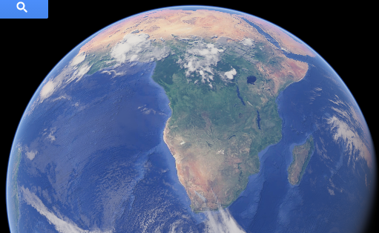
THANK YOU

