Slide 1
DRM/IFFs/ GOOD FINANCIAL GOVERNANCE
Conference on Improving Domestic Resource Mobilization and Stemming Illicit Financial Flows
Fanwell Kenala BOKOSI, PhD
14 March 2019
Nairobi

Slide 2

Governance
Africa
The manner in which the State
acquires and exercises its
authority to provide public
goods and services

Slide 3
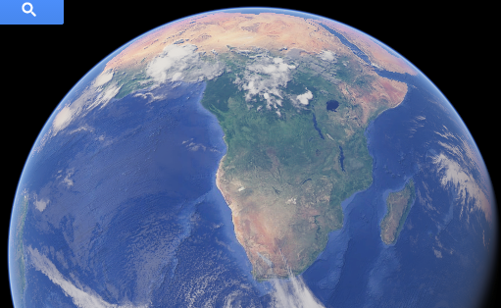
FINANCING DEVELOPMENT AFRICA
OTHER LEAKAGES
FOREIGN DIRECT INVESTMENT
AID
PUBLIC DEBT
PRIVATE INVESTMENT
PUBLIC SECTOR
PRIVATE SECTOR
REMITTANCES
TRENDS AND VOLUMES
DOMESTIC RESOURCES
ILLICIT FINANCIAL OUTFLOWS

Slide 11
THE DEVELOPMENTAL IMPACT
PUBLIC EXPENDITURE ON HEALTH
PUBLIC EXPENDITURE ON EDUCATION
HUMAN DEVELOPMENT INDEX

Slide 15
Conclusions
Illicit financial flows deprive developing countries of crucial resources needed for development
Developed countries’ maintenance of the system that allows this deprivation to occur is morally unjustifiable

Slide 16
Conclusions
The linkage of IFFs to Human Development Index makes IFFs one of the greatest human development challenges in the SADC Region
The loss of tax revenue resulting from IFFs hampers governments’ ability to provide services and infrastructure for their citizens
A rights-based approach to IFFs combines these perspectives, demonstrating the practical importance to developing countries of curbing IFFs while also providing a moral impetus for developed countries to do so
The loss of capital impedes the organic growth of the economy

