Slide 1
The rules of the game:
Clauses in tax treaties
& why they matter
Presentation By
Musonda Kabinga

Slide 2
Presentation Outline
Defining Double Taxation Agreements (DTA’s)
Taxing Rights in Tax Treaties
Restrictive Tax Treaties – Findings from ActionAid Mistreated Report
Revenue Losses As a Result of Unbalanced Tax Treaties
Recommendations

Slide 3
Double Taxation Agreements (Tax Treaties)
A tax treaty is a legally binding agreement between states, which governs the taxation of cross- border activities; namely investments by a resident of one state in the other state, and vice versa

Slide 4
Double Taxation Agreements
When states negotiate tax treaties, they look to model tax treaties. Countries can pick and choose clauses from these documents which operate like templates
The OECD model is the most influential, followed by the UN model. Even a treaty between two non-OECD countries is more likely to follow the OECD model than the UN model
States may also draw from other model tax treaties or draft their own clauses. In Africa alone, SADC (the Southern African Development Community), COMESA (the Common Market for Eastern and Southern Africa) and the EAC (the East African Community) have each developed their own model tax treaties. ECOWAS is in the process of developing one

Slide 5
Division of tax rights
Income or profits which result from international activities such as cross-border investment may be taxed:
Where the income is earned (the source country – source taxation), or
Where the company/investor that own shares in the local company are resident (the country of residence – residence taxation), or
Tax can be partly taxed at source, then the residence country has the remaining right to tax (capped source taxation rights).

Slide 6
The tax rights
Profit tax: tax treaties set the rules about how established a foreign multinational has to be before it pays tax on its profits – so-called permanent establishment clauses.
Withholding tax: a straightforward ‘grab it before it goes’ strategy that helps guarantee that foreign-owned businesses don’t transfer earnings out of a country without paying any tax. Very often restricted in treaties with so-called caps of taxation at source.
Capital gains tax: taxing the value increase when e.g. a mine or a building is sold at a gain has delivered multimillion dollar tax payments in lower-income countries, but the right to tax capital gains is at stake in 49% of treaties examined by ActionAid, simply called capital gains clauses.

Slide 7
The right to tax profits
What is this about: How established a foreign multinational has to be before it pays tax on its profits
Technical term: Permanent establishment
What’s a good deal for a developing country: A wide and extensive right to tax the profits of foreign companies that make money on their soil

Slide 8
The right to apply withholding taxes
What is this about: The right to tax money that foreign-owned businesses transfer out of the country. Dividends, interest, royalty (brands, know-how), services fees tax.
Technical term: Withholding tax
What’s a good deal for a developing country: No caps on their right to tax this money (or high caps, e.g. a maximum 20-30% tax rate)

Slide 9
The right to tax capital gains
What’s it about: Taxing the value increase when e.g. a mine or a building is sold at a gain.
Key fact: More than 70% of the tax treaties in the ActionAid’s analysis block the right to tax gains made by foreign corporations when they sell shares in local corporations.
What’s a good deal for a developing country: No caps on their right to tax.

Slide 10
Division of tax rights (UN Model& OECD Model)
Which Article | What is it About | What's Good for a Developing Country
UN Model Article (11) “Interest Payments” | Withholding tax rate: Interest UN =(WHT in 0%) * % to be established through bilateral negotiations OECD =(10%) | No threshold or (a high cap at 15%)
UN Model Article (5) “Permanent Establishment” | UN=(6 months test for a building or construction Site) OECD=(12 months) | No threshold or very few months
UN Model Article 12 (a) “Technical Services” | Withholding tax on payments of fees for technical services made to non-residents. Any payment in consideration for any service of a managerial, technical or consultancy nature UN = Yes OECD = No | No threshold or (a high cap at 15%)

Slide 11
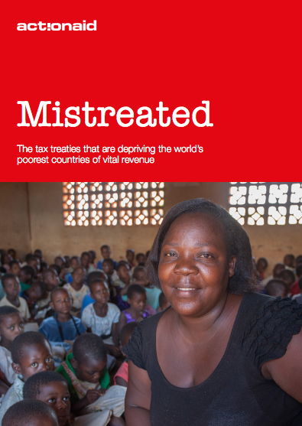
Unbalanced Taxing Rights – Revelations from the Mistreated Report
Treaties that lower-income countries have with OECD countries take away more rights to tax than treaties with fellow non-OECD countries, which tend to be more favorable for lower-income countries

Slide 12
Unbalanced Taxing Rights
Treaties with the UK and Italy had the highest number of treaties with lower income Asian and Sub-Saharan countries that are restrictive. This was followed by Germany with China, Kuwait and Mauritius building a rapidly growing number of very restrictive treaties
Tax treaties limit the taxing rights of countries that sign the treaty and companies may take advantage of the taxing restraints by structuring their investment in certain countries based on the availability of favourable treaties

Slide 13
Unbalanced Taxing Rights
A sample of modern era tax deals that completely ban tax on interest payments paid to overseas lenders in the treaty partner country
Party 1 | Party 2 | Signed | Status
Congo (Rep.) | France | 1987 | In force
Senegal | Quarter | 1998 | In force
Congo (Rep.) | Italy | 2003 | In force
Mozambique | United Arab Emirates | 2003 | In force
Zimbabwe Kuwait | Kuwait | 2006 | In force

Slide 14
Unbalanced Taxing Rights
Country 1 | Country 2 | Signed in Year | What’s the Problem
Guinea | United Arab Emirates | 2011 | Completely bans Guinea from taxing dividends, interest, royalty payments and professional service fees
Zambia | United Kingdom | 2014 | Blocks Zambia from taxing British companies any more than 5% on dividends from direct investments
Uganda | Netherlands | 2004 | Completely bans Uganda from taxing dividends of majority-owned companies and professional service fees. • The Netherlands has the full taxing right on these dividends, but generally, doesn’t tax
Senegal | Mauritius | 2002 | Completely bans Senegal from taxing dividends, interest, royalty payments and professional service fees. • Foreign-owned holding companies usually only face a 3% effective tax rate in Mauritius.

Slide 15
Counting the losses……..
Bangladesh has the highest number of very restrictive treaties with wealthier countries
Thirty different countries have negotiated dividend tax breaks for direct investment in treaties with Bangladesh, each making small savings for its multinationals
ActionAid estimates that these small cuts add up to US$85 million given away by Bangladesh in 2013 alone, due to a single rule in the country’s tax treaties

Slide 16
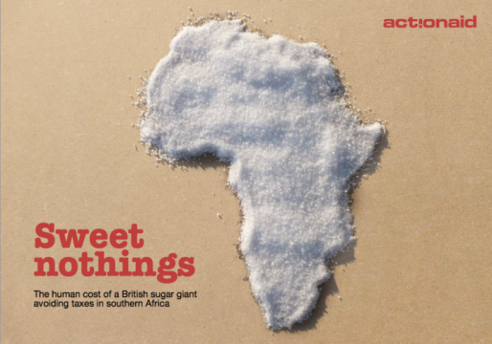
Counting the losses………….
We estimate that Irish transactions undertaken by Zambia Sugar through application of Zambia/Ireland tax treaty deprive the Zambian government of some nearly US$2 million a year – enough to cover the PTA fees for 180,000 Zambian schoolchildren - (Sweet Nothings, ActionAid Report - 2012)

Slide 17
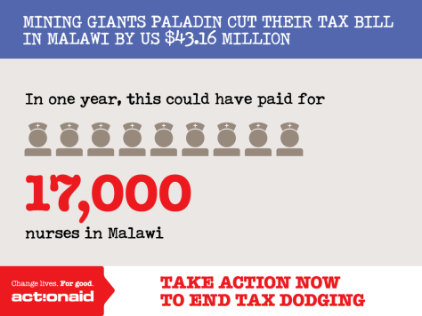
Counting the losses………….
Malawi
Has lost out on US$43 million in revenue as a result of the Zambia/Netherlands Tax Treaty between (2009 & 2014). This money could have paid for:
- 17,000 annual nurses salaries
- 39,000 annual teachers salaries
(An Extractive Affair, ActionAid Report - 2015)

Slide 18
Anti-abuse rules
What is this about: Restricting which companies that get the treaty ‘benefits’ (tax breaks).
To use these you need: resources & political will.
The headache: There is debate amongst experts about which types of clauses are most effective & the effectiveness will depend on the country's circumstances. Risk shifting jobs to developed countries?
Proposed approach: Get better informed by dialogue with the signature country’s governments.

Slide 19
Anti-abuse rules
A “principal purpose test” rule (PPT) / “main purpose” article / general anti-abuse rule:
Blocks the benefits of a treaty provision where taking advantage of that benefit was the main purpose of an activity.
Example: clauses 10(10), 11(9) and 12(8) of the Malawi - Netherlands renegotiated treaties https://zoek.officielebekendmakingen.nl/trb-2015-75.html
A “limitation-on-benefits” rule (LOB):
deny treaty benefits to corporations which do not have an adequate connection to a treaty country; is the presence in the country ‘real’ or ‘artificial’. Additional cover is generally thought to be required to cover against treaty shopping.
Example: http://www.oecd.org/tax/treaties/treaty-abuse-discussion-draft-march-2014.pdf (p. 5)
A “subject-to-tax” rule:
Remove treaty limitations to one country’s right to tax cross-border income if that income is not in fact subject to tax in the other country.

Slide 20
Recommendations
All governments should subject treaty negotiation, ratification and impact assessments to far greater public scrutiny – a tax treaty policy should be developed to guide the negotiation and conclusion of treaties, this could include the requirement for impact assessments and identify the types of officials who should be involved in negotiation.
All governments should consider the impact of tax treaties on tax revenue
Tax treaties that restrict the tax rights of low and lower-middle
income countries should be urgently reviewed. Governments can re-negotiate or even cancel treaties where they are found to be resulting in tax revenue losses. For instance, India is re-negotiating its treaty with Mauritius due to the treaty abuse by domestic and foreign companies that resulted in no capital gains being collected on the sale of shares

Slide 21
End of Presentation
Thankyou for Listening

